Slide 1

Network Management & Monitoring Overview
Network Management Tutorial
May 18
Cairo, Egypt
Hervey Allen, Phil Regnauld

Slide 2
Introduction
This is a big topic...
We'll try to respond to what you would like to hear.
There are a lot of tools to choose from:
  Open Source
  Commercial
  Linux/Unix-based
  Windows-based
  Network Vendor tools (Cisco, Juniper, others)
No one combination of tools is correct for everyone.
What you need to know about your network will drive your choice of tools.

Slide 3
Overview
What is network management and monitoring?
Why network management?
The Network Operation Center
Network monitoring systems and tools
Statistics and accounting tools
Fault/problem management
Ticket systems (more tomorrow)
Configuration management & monitoring
The big picture...

Slide 4
What is network management?
System & Service monitoring
  Reachability, availability
Resource measurement/monitoring
  Capacity planning, availability
Performance monitoring (RTT, throughput)‏
Statistics & Accounting/Metering
Fault Management (Intrusion Detection)
  Fault detection, troubleshooting, and tracking
  Ticketing systems, help desk
Change management & configuration monitoring

Slide 5
What we'll cover today...
SNMP
Configuration & Change Management
Logging
Flows
RRDTool/MRTG
Nagios
Documentation
Ticketing
Cacti and Smokeping

Slide 6
Big picture – First View
How it all fits together
Notifications
- Monitoring
- Data collection
- Accounting
Ticket
- Change control & monitoring
- Capacity planning
- Availability (SLAs)‏
- Trends
- Detect problems
- NOC Tools
- Ticket system
Ticket
- Improvements
- Upgrades
Ticket
Ticket
- User complaints
- Requests
Ticket
Fix problems

Slide 7
Why network management?
Make sure the network is up and running. Need to monitor it.
  Deliver projected SLAs (Service Level Agreements)‏
  Depends on policy
    What does your management expect?
    What do your users expect?
    What do your customers expect?
    What does the rest of the Internet expect?
  Is 24x7 good enough ?
    There's no such thing as 100% uptime

Slide 8
Why network management? - 2
Since you have switches that support SNMP…
Use public domain tools to ping every switch and router in your network and report that back to you
  Nagios – http://nagios.org/
  Sysmon - http://www.sysmon.org/
  Open NMS - http://www.opennms.org/
Goal is to know your network is having problems before the users start calling.

Slide 9
Why network management ? - 3
What does it take to deliver 99.9 % uptime?
  30,5 x 24 = 762 hours a month
  (762 – (762 x .999)) x 60 = 45 minutes maximum of downtime a month!
Need to shutdown 1 hour / week?
  (762 - 4) / 762 x 100 = 99.4 %
  Remember to take planned maintenance into account in your calculations, and inform your users/customers if they are included/excluded in the SLA
How is availability measured?
  In the core? End-to-end? From the Internet?)‏

Slide 10
Why network management? - 4
Know when to upgrade
  Is your bandwidth usage too high?
  Where is your traffic going?
  Do you need to get a faster line, or more providers?
  Is the equipment too old?
Keep an audit trace of changes
  Record all changes
  Makes it easier to find cause of problems due to upgrades and configuration changes
Where to consolidate all these functions?
  In the Network Operation Center (NOC)‏

Slide 11
The Network Operations Center (NOC)‏
Where it all happens
  Coordination of tasks
  Status of network and services
  Fielding of network-related incidents and complaints
  Where the tools reside (”NOC server”)‏
  Documentation including:
    Network diagrams
    database/flat file of each port on each switch
    Network description

Slide 12
Documentation
Document Switches
  What is each port connected to?
  Can be simple text file with one line for every port in a switch:
health-switch1, port 1, Room 29 – Director’s office
health-switch1, port 2, Room 43 – Receptionist
health-switch1, port 3, Room 100 – Classroom
health-switch1, port 4, Room 105 – Professors Office
…..
health-switch1, port 25, uplink to health-backbone
  Make this file available for all networking and help desk staff. Possibly available via your NOC, or on a wiki, such as Trac.
  Remember to label your ports!

Slide 13
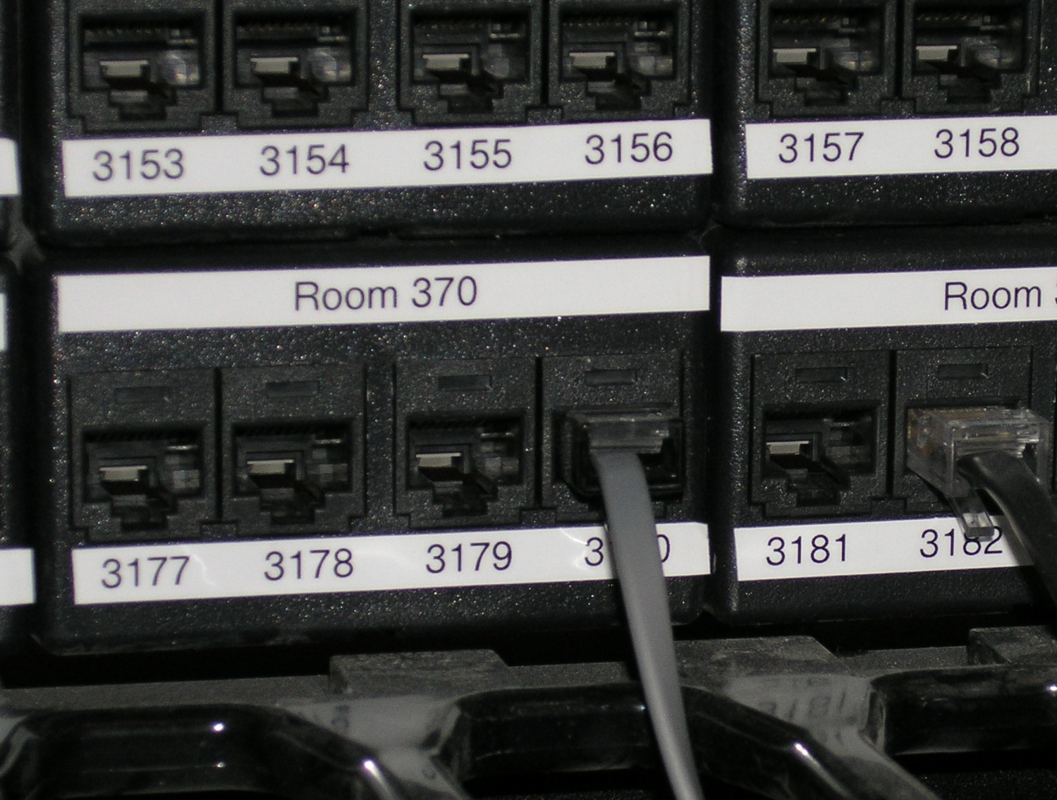
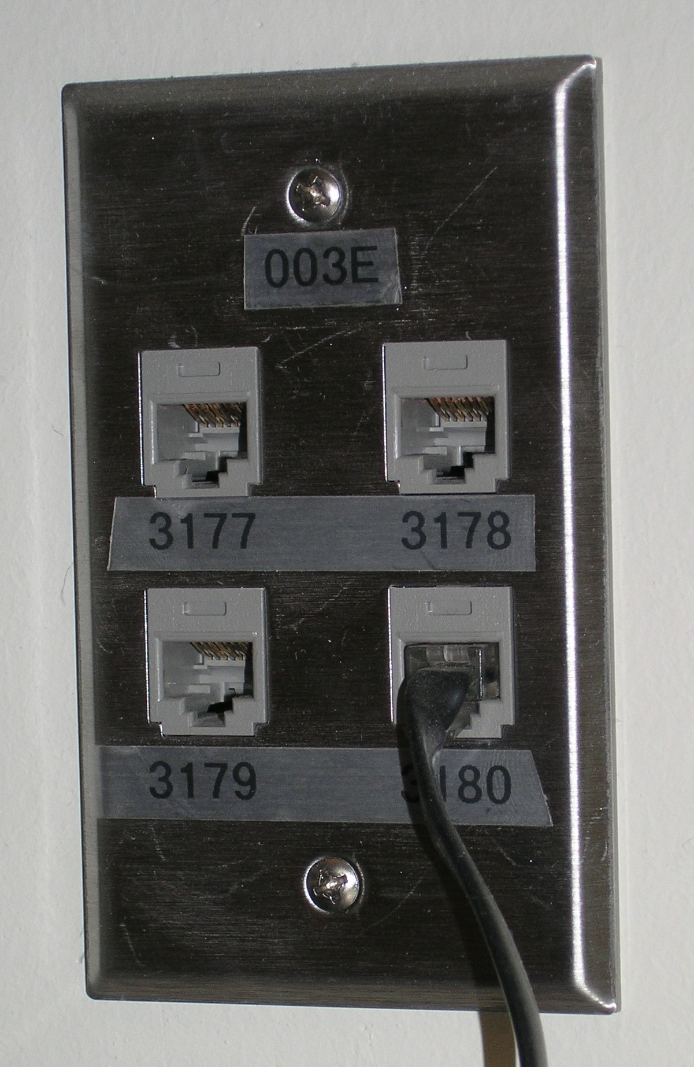
Documentation:
Labeling
Nice :-)

Slide 14
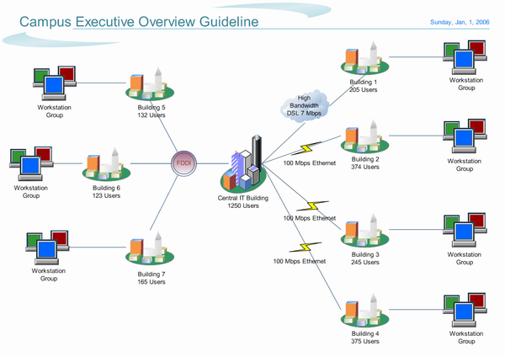
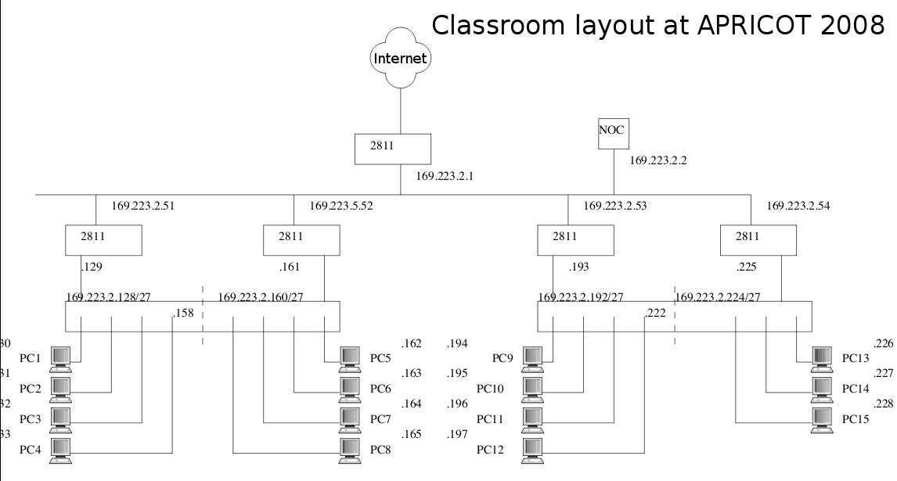
Documentation:
Diagrams

Slide 15
Documentation:
Diagramming Software
Windows Diagramming Software
Visio:
http://office.microsoft.com/en-us/visio/FX100487861033.aspx
Ezdraw:
http://www.edrawsoft.com/
Open Source Diagramming Software
Dia:
http://live.gnome.org/Dia
Cisco reference icons
http://www.cisco.com/web/about/ac50/ac47/2.html
Nagios Exchange:
http://www.nagiosexchange.org/

Slide 16
Network monitoring systems and tools
Three kinds of tools
  Diagnostic tools – used to test connectivity, ascertain that a location is reachable, or a device is up – usually active tools
  Monitoring tools – tools running in the background (”daemons” or services), which collect events, but can also initiate their own probes (using diagnostic tools), and recording the output, in a scheduled fashion.
  Performance tools – tell us how our network is handling traffic flow.

Slide 17
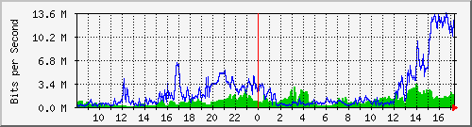
Network monitoring systems and tools - 2
Performance Tools
Key is to look at each router interface (probably don’t need to look at switch ports).
Two common tools:
  http://cricket.sourceforge.net/
  http://www.mrtg.com/

Slide 18
Network monitoring systems and tools - 3
Active tools
  Ping – test connectivity to a host
  Traceroute – show path to a host
  MTR – combination of ping + traceroute
  SNMP collectors (polling)‏
Passive tools
  log monitoring, SNMP trap receivers, NetFlow
Automated tools
  SmokePing – record and graph latency to a set of hosts, using ICMP (Ping) or other protocols
  MRTG/RRD – record and graph bandwidth usage on a switch port or network link, at regular intervals

Slide 19
Network monitoring systems and tools - 4
Network & Service Monitoring tools
  Nagios – server and service monitor
    Can monitor pretty much anything
    HTTP, SMTP, DNS, Disk space, CPU usage, ...
    Easy to write new plugins (extensions)‏
  Basic scripting skills are required to develop simple monitoring jobs – Perl, Shellscript...
  Many good Open Source tools
    Zabbix, ZenOSS, Hyperic, ...
Use them to monitor reachability and latency in your network
  Parent-child dependency mechanisms are very useful!

Slide 20
Network monitoring systems and tools - 5
Monitor your critical Network Services
  DNS
  Radius/LDAP/SQL
  SSH to routers
How will you be notified ?
Don't forget log collection!
  Every network device (and UNIX and Windows servers as well) can report system events using syslog
  You MUST collect and monitor your logs!
  Not doing so is one of the most common mistakes when doing network monitoring

Slide 21
Network Management Protocols
SNMP – Simple Network Management Protocol
  Industry standard, hundreds of tools exist to exploit it
  Present on any decent network equipment
    Network throughput, errors, CPU load, temperature, ...
  UNIX and Windows implement this as well
    Disk space, running processes, ...
SSH and telnet
  It's also possible to use scripting to automate monitoring of hosts and services

Slide 22
SNMP Tools
Net SNMP tool set
  http://net-snmp.sourceforge.net/
Very simple to build simple tools
  One that builds snapshots of which IP is used by which Ethernet address
  Another that builds shapshots of which Ethernet addresses exist on which port on which switch.

Slide 23
Statistics & accounting tools
Traffic accounting and analysis
  what is your network used for, and how much
  Useful for Quality of Service, detecting abuses, and billing (metering)‏
  Dedicated protocol: NetFlow
  Identify traffic ”flows”: protocol, source, destination, bytes
  Different tools exist to process the information
    Flowtools, flowc
    NFSen
    ...

Slide 24
Statistics & accounting tools
Non-netflow based tools
  ipfm
  pmacct

Slide 25
Fault & problem management
Is the problem transient?
  Overload, temporary resource shortage
Is the problem permanent?
  Equipment failure, link down
How do you detect an error?
  Monitoring!
  Customer complaints
A ticket system is essential
  Open ticket to track an event (planned or failure)‏
  Define dispatch/escalation rules
    Who handles the problem?
    Who gets it next if no one is available?

Slide 26
Ticketing systems
Why are they important ?
  Track all events, failures and issues
Focal point for helpdesk communication
Use it to track all communications
  Both internal and external
Events originating from the outside:
  customer complaints
Events originating from the inside:
  System outages (direct or indirect)‏
  Planned maintenance / upgrade – Remember to notify your customers!

Slide 27
Ticketing systems - 2
Use ticket system to follow each case, including internal communication
between technicians
Each case is assigned a case number
Each case goes through a similar life cycle:
  New
  Open
  ...
  Resolved
  Closed

Slide 28
Ticketing systems - 3
Workflow:
Ticket System Helpdesk Tech Eqpt
----------------------------------------------------------------
T T T T
query | | | |
from ---->| | | |
customer |--- request --->| | |
<- ack. -- | | | |
| |<-- comm --> | |
| | |- fix issue -> eqpt
| |<- report fix -| |
customer <-|<-- respond ----| | |
| | | |

Slide 29
Ticketing systems - 4
Some ticketing software systems:
rt
  heavily used worldwide.
  A classic ticketing system that can be customized to your location.
  Somewhat difficult to install and configure.
  Handles large-scale operations.
trac
  A hybrid system that includes a wiki and project management features.
  Ticketing system is not as robust as rt, but works well.
  Often used for ”trac”king group projects.

Slide 30
Network Intrusion Detection Systems - NIDS
These are systems that observe all of your network traffic and report when it sees specific kinds of problems
  Finds hosts that are infected or are acting as spamming sources.
  SNORT is the most common open source tool http://www.snort.org/

Slide 31
Configuration management & monitoring
Record changes to equipment configuration, using revision control (also for configuration files)‏
Inventory management (equipment, IPs, interfaces, etc.)‏
Use versioning control
  As simple as:
  ”cp named.conf named.conf.20070827-01”
For plain configuration files:
  CVS, Subversion
  Mercurial

Slide 32
Configuration management & monitoring - 2
Traditionally, used for source code (programs)‏
Works well for any text-based configuration files
  Also for binary files, but less easy to see differences
For network equipment:
  RANCID (Automatic Cisco configuration retrieval and archiving, also for other equipment types)‏

Slide 33
Big picture - Again
How it all fits together
Notifications
- Monitoring
- Data collection
- Accounting
Ticket
- Change control & monitoring
- Capacity planning
- Availability (SLAs)‏
- Trends
- Detect problems
- NOC Tools
- Ticket system
Ticket
- Improvements
- Upgrades
Ticket
Ticket
- User complaints
- Requests
Ticket
Fix problems

Slide 34
Summary of Open Source Solutions
Performance
Cricket
IFPFM
flowc
mrtg
netflow
NfSen
ntop
pmacct
rrdtool
SmokePing
SNMP/Perl/ping
Net Management
Big Brother
Big Sister
Cacti
Hyperic
Munin
Nagios*
Netdisco
OpenNMS
Sysmon
Zabbix
ZenOSS
Change Mgmt
Mercurial
Rancid (routers)
RCS
Subversion
Security/NIDS
Nessus
OSSEC
Prelude
Samhain
SNORT
Untangle
Ticketing
RT & Trac

Slide 35
Questions ?
?

